Slide 1

Introduction to Probability and Statistics
Twelfth Edition
Robert J. Beaver • Barbara M. Beaver • William Mendenhall
Presentation designed and written by:
Barbara M. Beaver

Slide 2
Introduction to Probability and Statistics
Twelfth Edition
Introduction
Train Your Brain for Statistics
Some graphic screen captures from Seeing Statistics ®
Some images © 2001-(current year) www.arttoday.com

Slide 3

What is Statistics?
What does a
statistician do?
Player Games Minutes Points Rebounds FG%
Bob 34 32.7 24 7.6 .552
Andy 36 31.5 21 8.4 .465
Larry 30 33.0 18 5.6 .493
Michael 31 35.1 29 6.1 .422

Slide 4
Job of a Statistician
Collects numbers or data
Systematically organizes or arranges the data
Analyzes the data…extracts relevant information to provide a complete numerical description
Infers general conclusions about the problem using this numerical description

Slide 5
Uses of Statistics
Statistics is a theoretical discipline in its own right
Statistics is a tool for researchers in other fields
Used to draw general conclusions in a large variety of applications

Slide 6
POLITICS
If the election for mayor of Los Angeles were held today, who would you be more likely to vote for?
James Hahn 32%
Magic Johnson 36%
Someone else 11%
No opinion yet 21%
Forecasting and predicting winners of elections
Where to concentrate campaign appearances, advertising and $$…

Slide 7
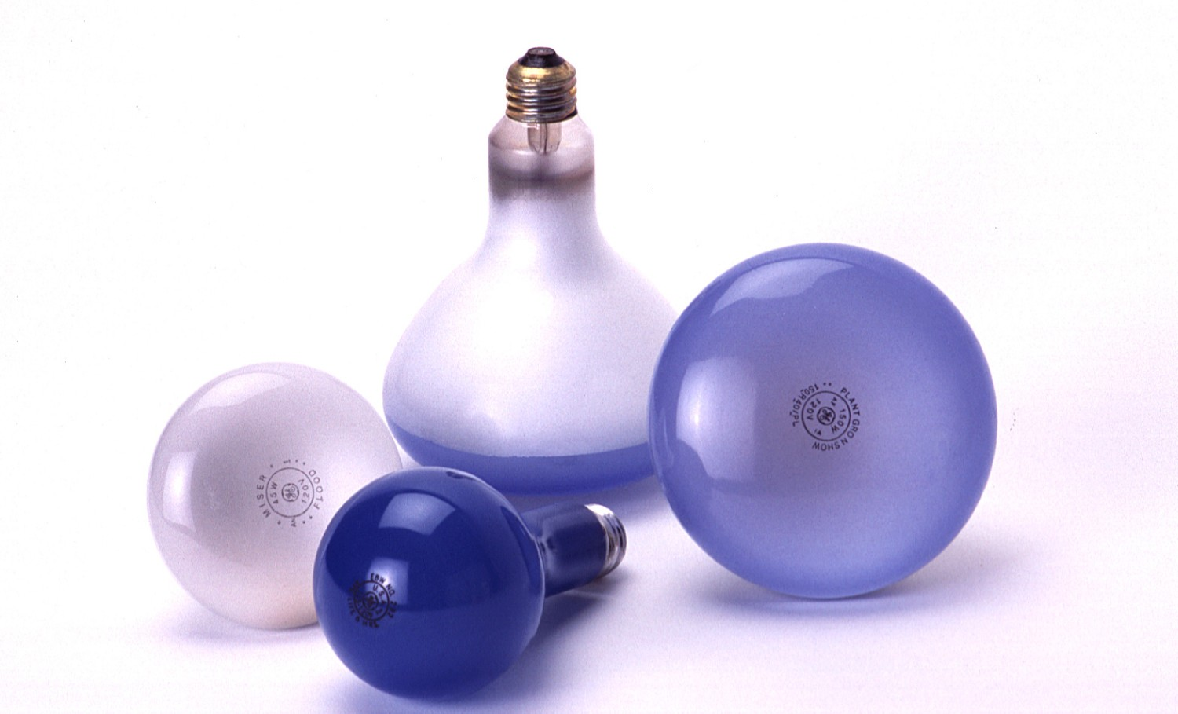
INDUSTRY
To market product…
Interested in the average length of life of a light bulb
Cannot test all the bulbs

Slide 8
OPINION POLLS
THE WAR ON TERRORISM
Do you think that the United States war on terrorism will spread to countries other than Afghanistan and Iraq?
YES 64% NO 34%
Do you think that the United States should be directly involved in negotiating peace agreements in other parts of the world?
YES 62% NO 31%

Slide 9
Common Problem
Decision or prediction about a large body of measurements which cannot be totally enumerated.
POPULATION: The set of all measurements of interest to the experimenter.

Slide 10
Examples
Light bulbs (to enumerate population is destructive)
Forecasting the winner of an election (population too big; people change their minds)

Slide 11
Solution
Collect a smaller set of measurements that will (hopefully) be representative of the larger set.
SAMPLE: A subset of measurements selected from the population of interest.

Slide 12
“Sample” and “Population”
Distinguish between set of objects on which we take measurements and the measurements themselves.
  Experimental Units: The items or objects on which measurements are taken
  Sample (or Population): the set of measurements taken on the experimental units.

Slide 13
Examples
Light bulbs
  Experimental unit = bulb
Opinion polls
  Experimental unit = person

Slide 14
Descriptive Statistics
Sometimes (but rarely) we can enumerate the whole population
If so, we need only use
DESCRIPTIVE STATISTICS: Procedures used to summarize and describe the set of measurements.

Slide 15
Inferential Statistics
When we cannot enumerate the whole population, we use
INFERENTIAL STATISTICS: Procedures used to draw conclusions or inferences about the population from information contained in the sample.

Slide 16
The Objective of
Inferential Statistics
To make inferences about a population from information contained in a sample.
The statistician’s job is to find the best way to do this.

Slide 17
But, our conclusions could be incorrect…consider this internet opinion poll…
Who makes the best burgers? | Votes | Percent
McDonalds | 123 Votes | 13%
Burger King | 384 Votes | 39%
Wendy’s | 304 Votes | 31%
All three have equally good burgers | 72 Votes | 7%
None of these have good burgers | 98 Votes | 10%
We’ll PAY CASH For Your Opinions!
(as much as $50,000 ) Click Here and sign up FREE!
We need a measure of reliability.

Slide 18
The Steps in Inferential Statistics
Define the objective of the experiment and the population of interest
Determine the design of the experiment and the sampling plan to be used
Collect and analyze the data
Make inferences about the population from information in the sample
Determine the goodness or reliability of the inference.

Slide 19
Learn to View Statistics with a Critical Eye
There are three kinds of lies…..
  Lies
  Damn Lies
  Statistics
You need to make statistics work for you, not lie for you!

